Slide 1
Predicting Miscarriage Using Vaginal Microbiomes
By: Mariam Elsharkawy, Faith Egbeni, Joann Tran, Kacee Chan, Yuyan Huang, and Gayathri Govind
Lead TAs: Leen Arnaout & Oluwaseun Adegbite
Assistant TA: Anjali Singh

Slide 2
Overview
01
02
03
04
Data & Algorithms
Introduction
Vaginal Microbiome and Miscarraige
Supervised vs. Unsupervised
Impact
Results & Analysis
Real World
Applications

Slide 3
Introduction

Slide 4
What is a Miscarriage?
Introduction
Miscarriage, or the failure of a pregnancy to continue beyond the 20th week, mostly occur due to the fetus not developing as expected.
10-15% of all pregnancies end in miscarriage
It can be physically challenging for the pregnant person due to a number of factors:
* Inability to clear miscarriage on its own
* Could lead to infertility
Notes:
(This is for point 1)It is a physically challenging condition for the pregnant person, and they could experience a rollercoaster of emotions afterwards. It is emotionally devastating for the pregnant person, and the people trying to conceive.
Most miscarriages (80%) happen within the first three months of pregnancy (up to 13 weeks of pregnancy).
Some common risk factors for miscarriages range from age(studies show that the risk of miscarriage rises to about 25% for people by age 40), previous miscarriage, and health conditions, such as unmanaged diabetes or issues with the uterus.
(Point 4) Beyond this, there is a lot we haven’t discovered about how the vaginal microbiome makeup can affect a pregnancy outcome.

Slide 5
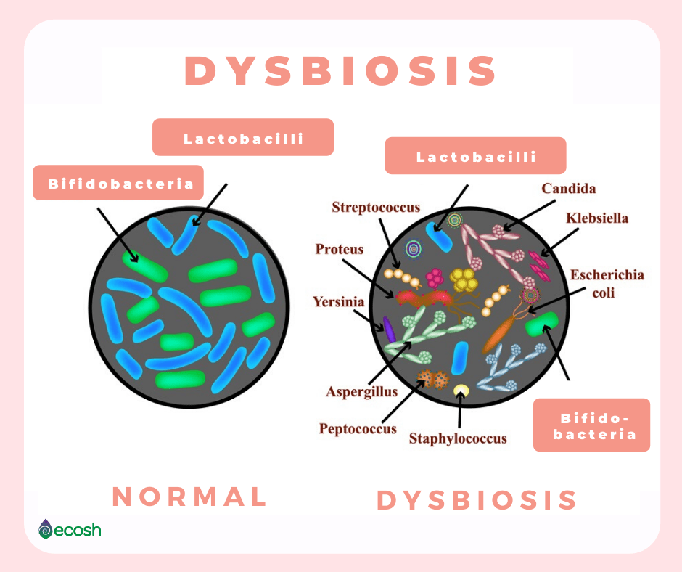
Causes of Miscarriage
Introduction
Chromosomal abnormalities cause about 50% of all miscarriages in the first trimester(13 weeks) of pregnancy.
In recent data, research has also shown that one of the most common causes of miscarriages can be dysbiosis, or imbalances of the vaginal microbiome.
Notes:
Some other causes of miscarriage include problems with the uterus or cervix, translocation, and more.
Before the new research, there was a large percentage of unexplained causes of miscarriage.

Slide 6
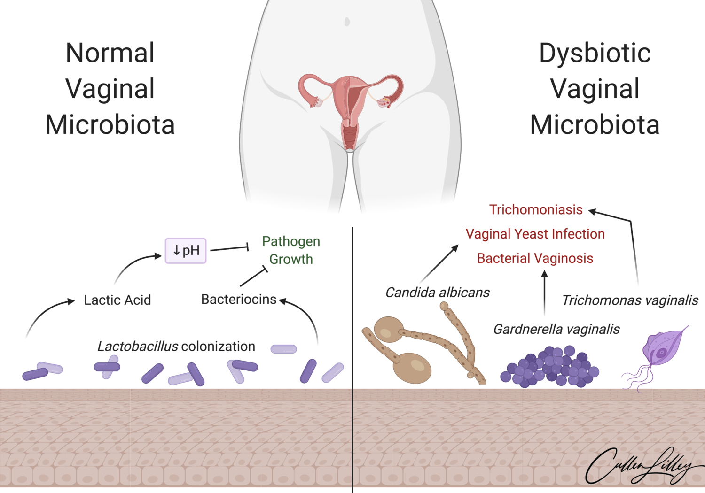
Vaginal Microbiome
Introduction
Imbalance of healthy and unhealthy bacteria in vagina increases likelihood of miscarriage
Notes:
The vagina, or the birthing canal, typically contains many naturally-occurring and healthy bacteria which work to keep the vagina protected and in good condition.
However there can also be unhealthy bacteria, and where there is an imbalance of this, miscarriages are more prone to happen.
Healthy Bacteria:
Lactobacilli
Unhealthy Bacteria:
Gardnerella vaginalis (bacterial vaginosis)
Unhealthy bacteria can cause a number of problems, it can trigger infections and inflammatory responses, leading to miscarriage, during pregnancy.

Slide 7
Objective
Introduction
Develop different types of machine learning models to predict the likelihood of a miscarriage based on a patient’s vaginal microbiome
Notes:
We tested 4 types of machine learning algorithms: decision trees, random forest, logistic regression, and k means clustering

Slide 8
Data & Algorithms

Slide 9


Data Used
Data & Algorithms
Data from 2019 Imperial College London study
The data contained DNA sequences from microbiome samples and whether a miscarriage occured
Needed to clean data so we could predict miscarriage
Notes:
The data we used comes from a 2019 Imperial College London study in which 161 pregnancies were analyzed.
The data contained DNA sequences from vaginal microbiome samples and also if a miscarriage occured and in which trimester it happened.
In order to use the data in our algorithms, we needed to clean it so we could predict whether this would be whether a miscarriage would occur or not based on data from their vaginal microbiome.

Slide 10
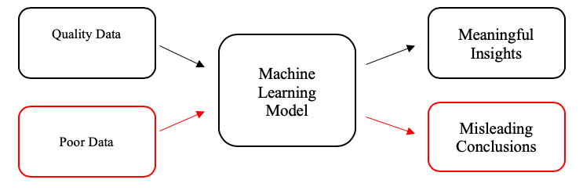

Data & Algorithms
Data Prep
Notes:
In machine learning, models learn statistical associations from their training data. the models can only be as good as the data they learn from, that’s why doing some data prepping to have high quality data is so important
One step took to prep the data was running the patient data sequences through blastx (a Basic Local Alignment Search Tool) to get the abundances of the types of bacteria for each patient.
We also changed the data classifications of the women’s pregnancy status to a binary type, so that the machine models could determine the likelihood of a yes or no outcome, whether the women had a successful pregnancy or not

Slide 11
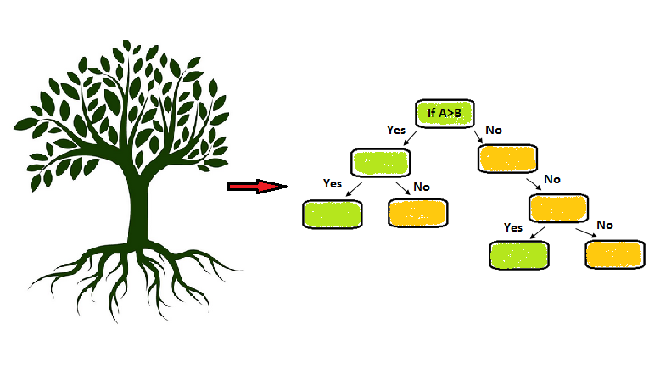
Algorithm:
Data & Algorithms
decision tree
Notes:
We decided to test four algorithms, one of which was the Decision Tree algorithm.
The Decision Tree algorithm involves selecting features from our dataset, such as a specific bacteria, and transforming them into decisions we can use to separate our class labels, like miscarriage vs. successful pregnancy, from each other.
The decision tree algorithm turned out to be the least accurate of the four, being less accurate than flipping a coin on average, so we turned our attention to the random forest algorithm.

Slide 12

Algorithm:
Data & Algorithms
random forest
Notes:
You can think of the random forest algorithm as a collection of decision trees, but intertwined. The random forest algorithm gives the majority outcome of multiple decision trees. Like in the diagram, if you have one decision tree with an outcome of class-a, and two with an outcome of class-b, the random forest algorithm will return the majority outcome, which is class-b.
We found that the random forest algorithm was much more accurate at predicting miscarriages and consistent than the decision tree, but we still needed to test a few other algorithms.

Slide 13
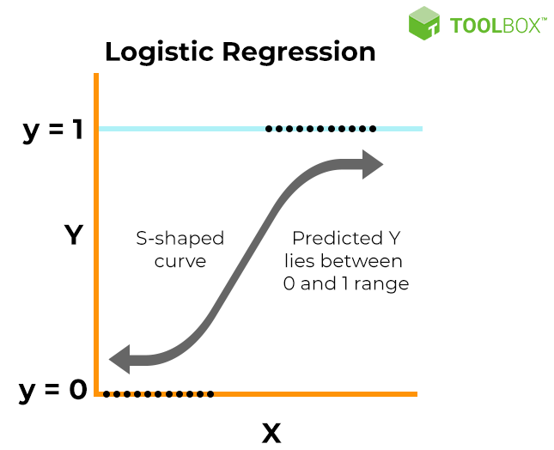
Data & Algorithms
Algorithm:
logistic regression
Notes:
Another supervised machine learning algorithm we tested was a logistic regression model
Log regression models are used to calculate the probability of a binary event occurring
It uses past data about earlier outcomes involving the same input criteria, to then score new cases on their probability of falling into one of two outcome categories.
So In our case we used a logistic regression model to determine the likelihood of a woman to have a miscarriage or successful pregnancy based on past data about women’s vaginal microbiome and the type of pregnancy they had

Slide 14
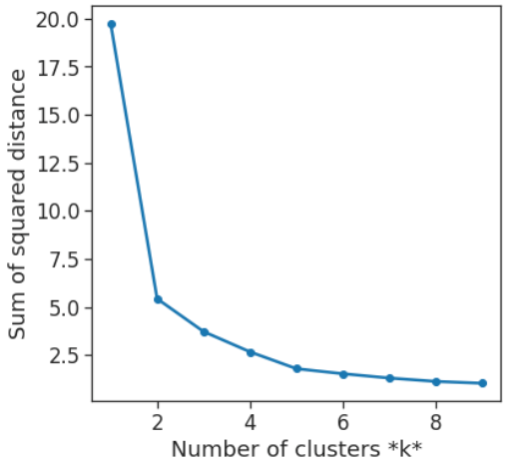
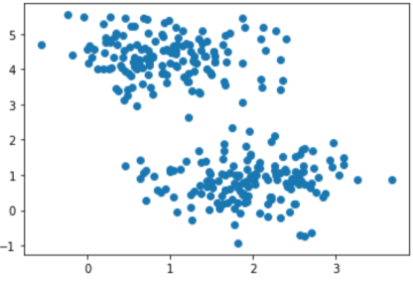
Data & Algorithms
Unsupervised Learning Algorithm:
k means clustering
Notes:
Tries to classify the data into groups without any guidance or labeled data
K-means clustering is a common example of an exclusive clustering method where data points are assigned into K groups
When we ran this model, we found there to be 2 ideal clusters, one for miscarriages and the other for successful pregnancies. This did not give us any useful information, as we already knew the status of each pregnancy.
This is because K means clustering is more suitable for continuous data, where as we had binary data

Slide 15
Results & Analysis

Slide 16
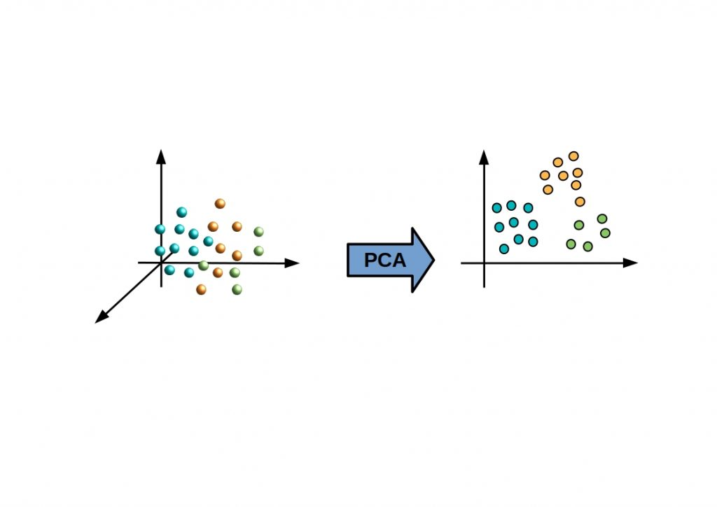
Results & Analysis
Principal Components Analysis (PCA):
Dimensionality-reduction method that is used to reduce large data sets
Transforms a large set of variables into a smaller one that still contains most of the information in the large set.
PCA is only a reliable method if the data are at least interval scaled and approximately normally distributed.
Notes:
PCA stands for Principal components analysis. It is Dimensionality-reduction method that is used to reduce large data sets, by transforming a large set of variables into a smaller one that still contains most of the information in the large set. PCA is only a reliable method if the data are at least interval scaled and approximately normal distributed.
-The figure shows the basic principle of a PCA. High dimensional data relationships should be represented in a low dimensional way, with as little loss of information as possible.

Slide 17
Results & Analysis
Accuracy Scores
Code: classifier.score(X_test, y_test)
The closer the score is to 1, the more accurately the algorithm can predict the likelihood of miscarriage from microbiome data (true positive / number of samples)
Used to objectively compare different algorithms
Notes:
The code classifier.score(X_test, y_test) is the code we use to calculate the accuracy score. We used these accuracy scores to be able to objectively compare different algorithms. The closer the score is to 1, the more accurately the algorithm can predict the likelihood of miscarriage from microbiome data (the number of samples we have).

Slide 18
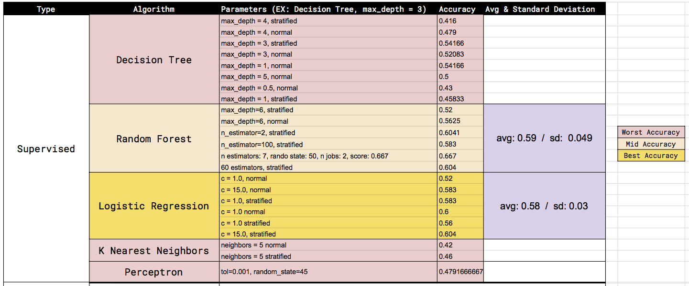
Results & Analysis
Accuracy Scores
Notes:
Keeping in mind the importance of using accuracy scores, our group tested various different parameters within each machine learning algorithm and compiled it in this spreadsheet. We then characterized the different algorithms based on their level of accuracy, which enabled us to find the two best algorithms, which were random forest and logistic regression.

Slide 19
Results & Analysis
Comparing Algorithms
Notes:
To compare these different algorithms, we calculated the mean and standard deviation of each algorithm’s accuracy scores. Although both algorithms had similar average accuracy scores

Slide 20
Results & Analysis
Final Algorithm Choice
More Reliable / Consistent
Notes:
our final algorithm was logistic regression since its standard deviation was much lower (0.03). A low standard deviation indicates the data points are close to the mean of 0.58, which signals a better consistency of data, and thus enhanced reliability of the logistic regression model. This was in contrast to random forest, whose accuracy scores were less consistent and much more dispersed from the mean.

Slide 21
Results & Analysis
Quantifiable Results
Notes:
We also wanted to highlight the highest accuracy score of the logistic regression model, which was 0.604 or 60.4% as a quantifiable result of our research.

Slide 22
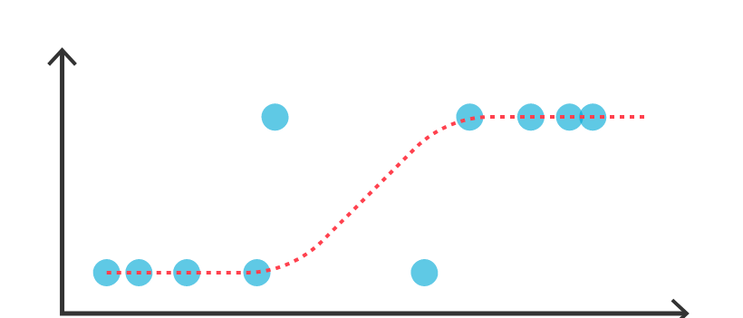
Our Best Algorithm
Results & Analysis
Logistic Regression
Most reliable / consistent algorithm
S-curve is good at approximating datasets with binary classifications
Notes:
After all the comparison, we found that Logistic regression was the most accurate and reliable/consistent algorithm, since logistic regression naturally has an s-curve that makes it very good at approximating datasets with binary classifications, which best describes our binarized dataset (composed of 2 groups: the group of miscarriages and a group of successful pregnancies)

Slide 23
Limitations
Notes:
In light of these findings, we must also address the limitations of our model.

Slide 24
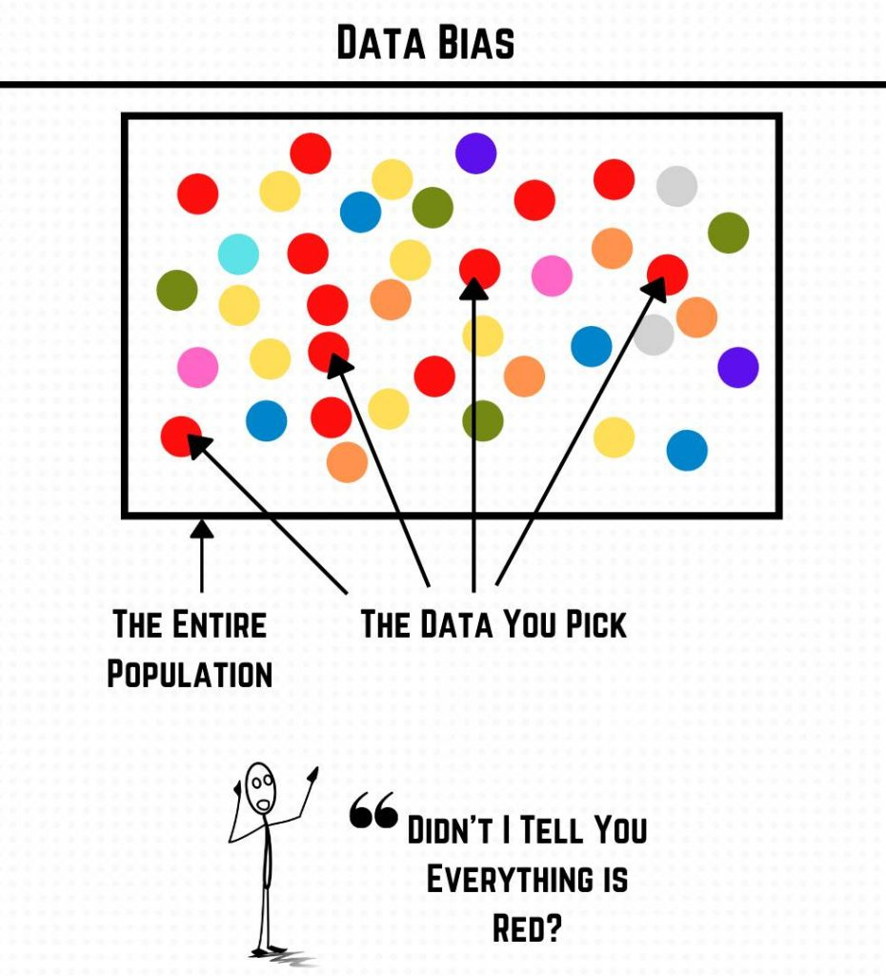
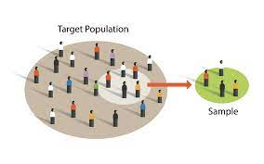
Limitations & Resolutions
Limitations:
Data bias
-large enough sample size
-information about the patients
Unknown sampling method
Misrepresentation of the population
Resolutions:
Larger sample data set
1000 samples per class
Randomly sampled
Notes:
Some of the limitations we encountered were a small sample size, insufficient info about the patient demographic, and unknown sampling method which could lead to data bias and misrepresentation.
To combat these issues in future projects, we could use a larger sample data set, at least 1000 samples per class to ensure fair representation and make sure the data used is randomly sampled to properly represent the target population and eliminate sampling bias.
This study contain data bias. It didn’t reflect the diversity of people who can get pregnant well, because we didn’t have a large enough sample size and enough information about the patients. We don’t know the patient ages, demographic information. Which could have lead to bias and misrepresentation of the population. (For example, miscarriages that may be due to genetic, anatomic, or other confounding variable, and not due to bacterial infection.) The study also didn’t mention how they collected the data, whether it’s voluntary, convenience or other sampling method.

Slide 25
Applications

Slide 26
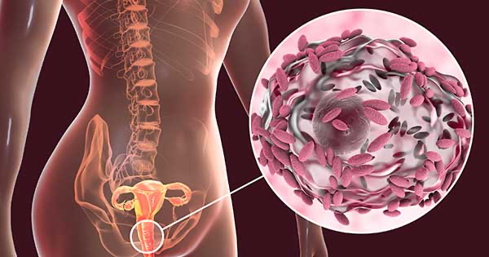
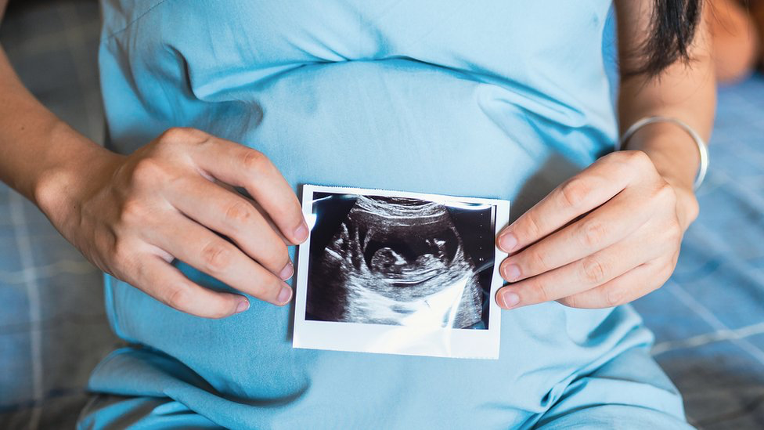
Applications
Understand harmful bacteria in microbiome
Prevent miscarriages
Notes:
-after running our data through multiple algorithms and now we can use this data to prevent miscarriages as we now know how to predict them because we now have a better understanding on the certain bacterias that are more likely to cause a miscarriage
-We could use this understanding of our data to find out how to avoid these bacterias as a first step of understanding how to prevent miscarriages
-We could also potentially use this data to assist doctors while treating pregnant patients in order to prevent miscarriages
-The eventual goal of all this would be to actually use all this data to prevent miscarriages from happening at all which would have a large impact on society
-This project gave us an opportunity to put our developing skills in machine learning and coding in python to a real world application as we analyzed real data and tested them through various algorithms to find our best result
-due to this exposure we learned more about coding and troubleshooting and what to do in such situations
-we also got exposure to classifying and cleaning data, using the train-test split and stratification, all tools that can help us in further experiences in AI or machine learning
-We ran our data through multiple algorithms and now we can use this data to prevent miscarriages as we now know how to predict them because we now have a better understanding on the certain bacterias that are more likely to cause a miscarriage
-We could use this understanding of our data to find out how to avoid these bacterias as a first step of understanding how to prevent miscarriages
-We could also potentially use this data to assist doctors while treating pregnant patients in order to prevent miscarriages
-The eventual goal of all this would be to actually use all this data to prevent miscarriages from happening at all which would have a large impact on society

Slide 27
Works Cited
PCA: https://builtin.com/data-science/step-step-explanation-principal-component-analysis
https://starship-knowledge.com/pca-vs-linear-regression
Intro miscarriage: https://my.clevelandclinic.org/health/diseases/9688-miscarriage
Logistic regression image:
Source: https://www.tibco.com/reference-center/what-is-logistic-regression
Random forest image:
https://en.wikipedia.org/wiki/Random_forest
Decision tree image:
https://towardsai.net/p/machine-learning/fully-explained-decision-tree-classification-with-python

Slide 28
Thanks!
Do you have any questions?

Slide 29
Introduction (Kacee & Gayathri)
Contextualize issue
Explain link of vaginal microbiome and miscarriage
Intro to project
Data (faith )
What data we’re using (inputs and outputs) (faith)
High quality vs low quality data
how we cleaned it up / feature engineering (Joann)
Algorithms: (Brief overview of what it does (parameters) & sample code)
Supervised Learning
Decision Tree (faith)
Brief explanation of Random Forest
Logistic Regression (Joann)
Unsupervised Learning (kc)
Brief explanation of K- Means Clustering
Results/Analysis (Mariam & Yuyan)
Explain why this algorithm is the best (accuracy and reliability)
Explain how we derived an accuracy score
Applications to the real world/connect it back to the real world(Gayathri, Yuyan)
Things you learned, things to improve on (constraint-wise, limitations) (gayathri)
Data bias/can this be generalized (Yuyan)

Slide 30
Generalizability
Results & Analysis
Highest Score
60.4%
Not very generalizable to sample population
Notes:
However, since the highest accuracy score of the logistic was 60.4%, the model is not very generalizable to our sample population, but still provides essential applications to the real world (transition to real-world applications slides)

Slide 31
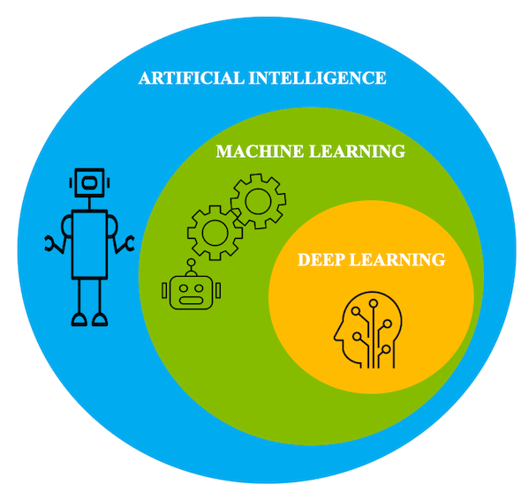
Applications
-This project gave us an opportunity to put our developing skills in machine learning and coding in python to a real world application as we analyzed real data and tested them through various algorithms to find our best result
-due to this exposure we learned more about coding and troubleshooting and what to do in such situations
-we also got exposure to classifying and cleaning data, using the train-test split and stratification, all tools that can help us in further experiences in AI or machine learning
We ran our data through multiple algorithms and now we can use this data to prevent miscarriages as we now know how to predict them because we now have a better understanding on the certain bacterias that are more likely to cause a miscarriage
We could use this understanding of our data to find out how to avoid these bacterias as a first step of understanding how to prevent miscarriages
We could also potentially use this data to assist doctors while treating pregnant patients in order to prevent miscarriages
The eventual goal of all this would be to actually use all this data to prevent miscarriages from happening at all which would have a large impact on society
-
Notes:
Skills wise :

